Slide 1

.
we are committed to enrich and nurture every society with our quality. We stand for a healthy life(our purpose)…….

Slide 2

Mission.
Our mission is to touch as many lives as possible through our nutritious quality by being able to attend to every level of persons(as far as our reach can expand), also reflecting our quality in the services we bring to people and successfully distinguishing our drink from the mass market of soya drinks found in Nigerian stores today.

Slide 3

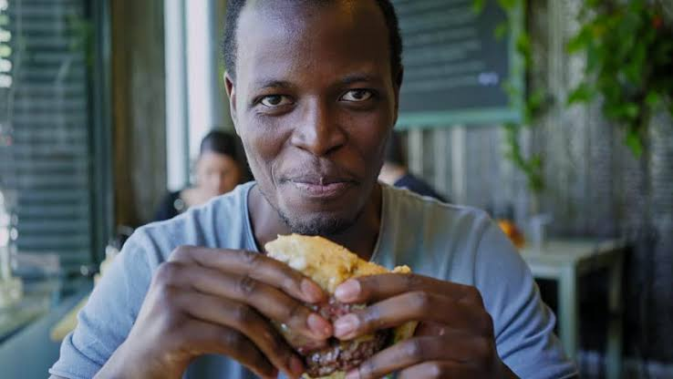
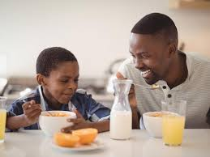
AIM & PURPOSE.
Due to eavor milks' nutritional values,
Our attenton is to all socioeconomic level ,
women with pre and post menopausal syndrome as a supplementry therapy for relief,
every hustling male and female attending to their daily activities as a supplememtry diet to their casual intakes etc...
we want to make eavor milk next to possibly every meal and affordable, the taste is different, creamy and satisfying and we want to make it even better.

Slide 4
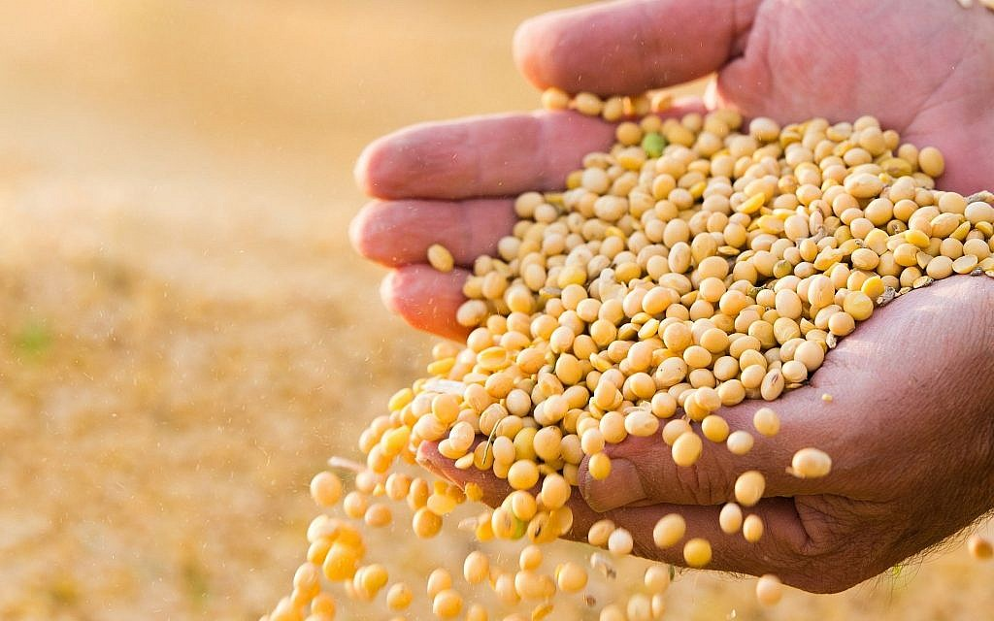
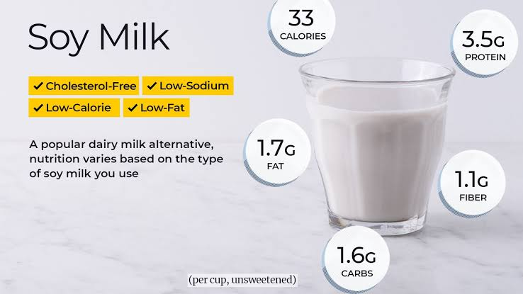
EAVOR MILK nutritional contents and benefits.
Eavor milk is produced from whole soybean seed.
it contains as much protein as cow milk, yet lower in calories.
its a good source of potassium and magnesium and can be fortified with vit. A and D
it contains very little saturated fat
boasts riboflavin(vit, B2 and B12)
Soymilk provides some relief from postmenopausal issues. Studies suggest that soy isoflavones help maintain estrogen levels in menopausal women

Slide 5
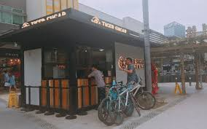
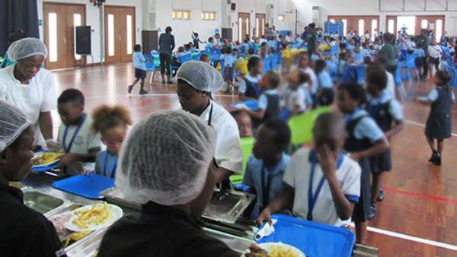
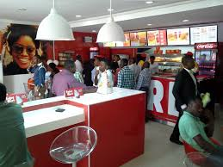
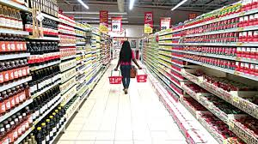
HOW TO GET TO PEOPLE.
Eavor foods already has milk service joints(green houses) around the founded home town,putting up more at strategic places ranging from eavor home town down to the whole city and then other states in the home country.
Also putting up eavor milk depors in every state we introduce eavor milk
Ranging our services from local stores down to eatries, pastries and supermarkets, even in schools.
Building an online platform/store for flexible service
Advertisement.

Slide 6
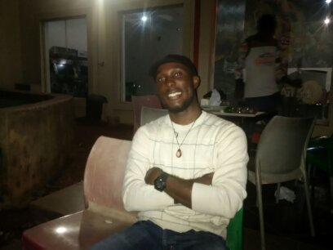
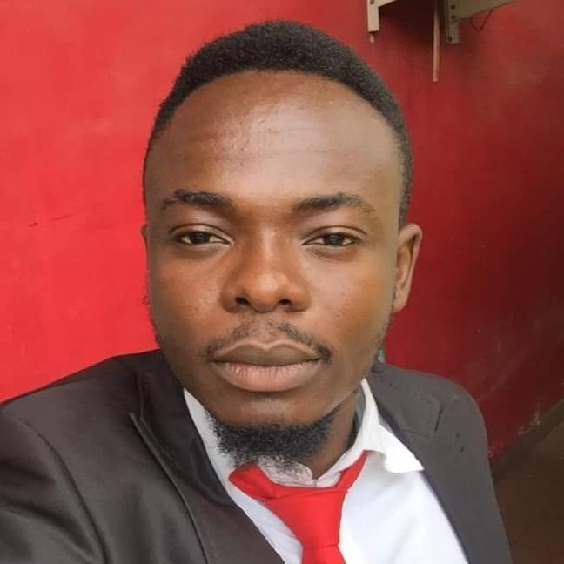
THE TEAM.
Ayalogu Byron
Founder eavor foods.
Bachelors degree in Mech. Engr
Work experience at Phinomar milling and foods Nig Ltd.
Note; “one of my biggest challanges now in Nigeria is getting a team of people i can work with who understands eavor concept forms a pattern with it and can't compromise without relying on salaries immediately”.
“i am insearch for a food science and technology personnel, not just anyone, someone that is attracted to creating solutions”
Maxwell Odimkpa
IT and Media consultant.
Bachelors degree in Computer Engr.

Slide 7
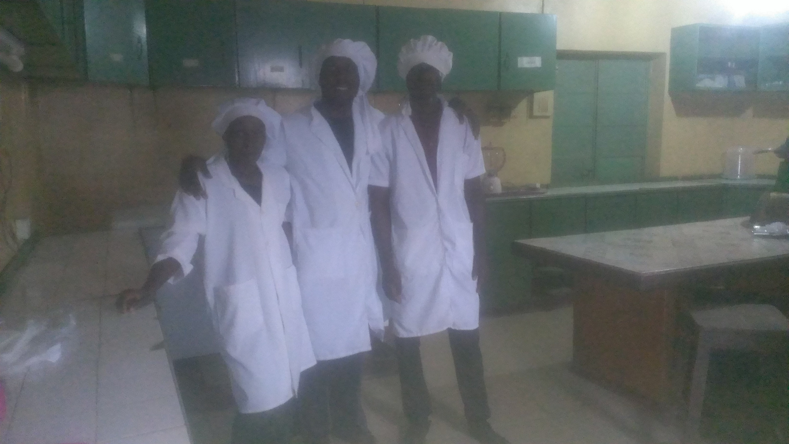
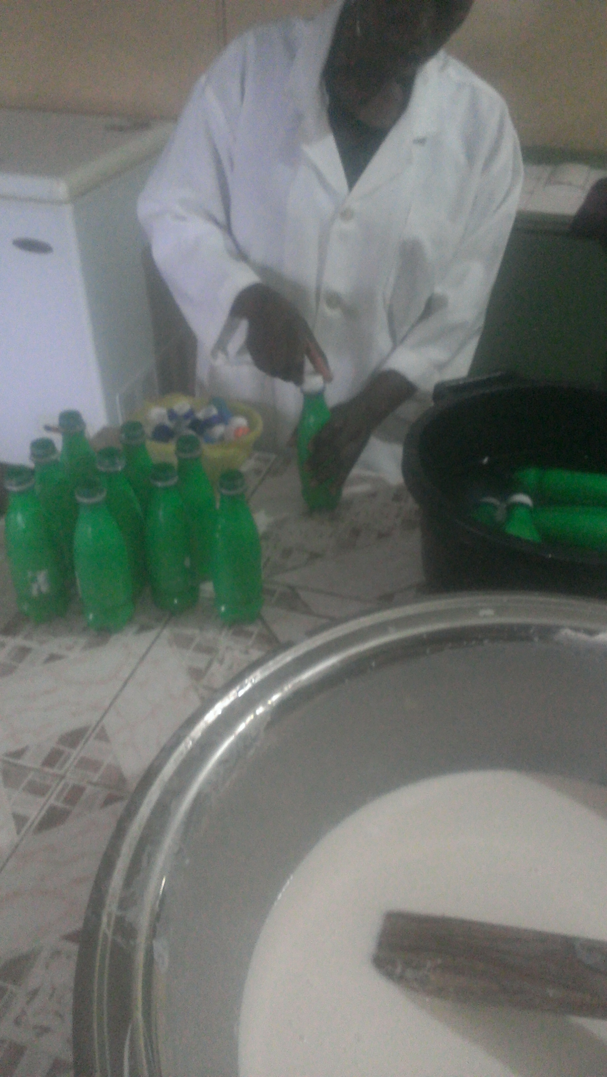
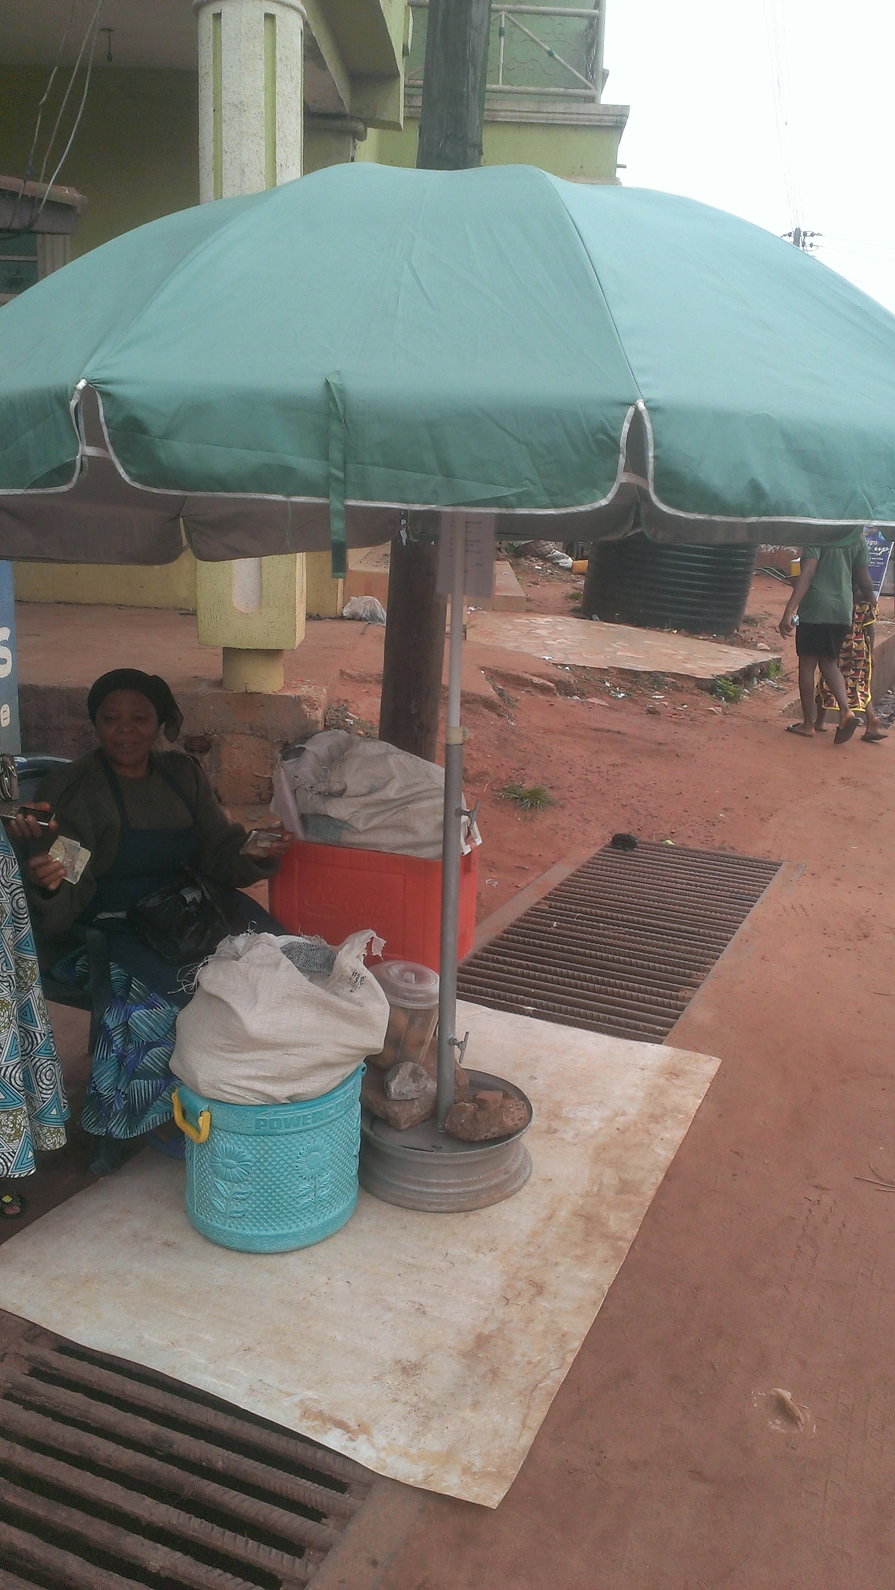
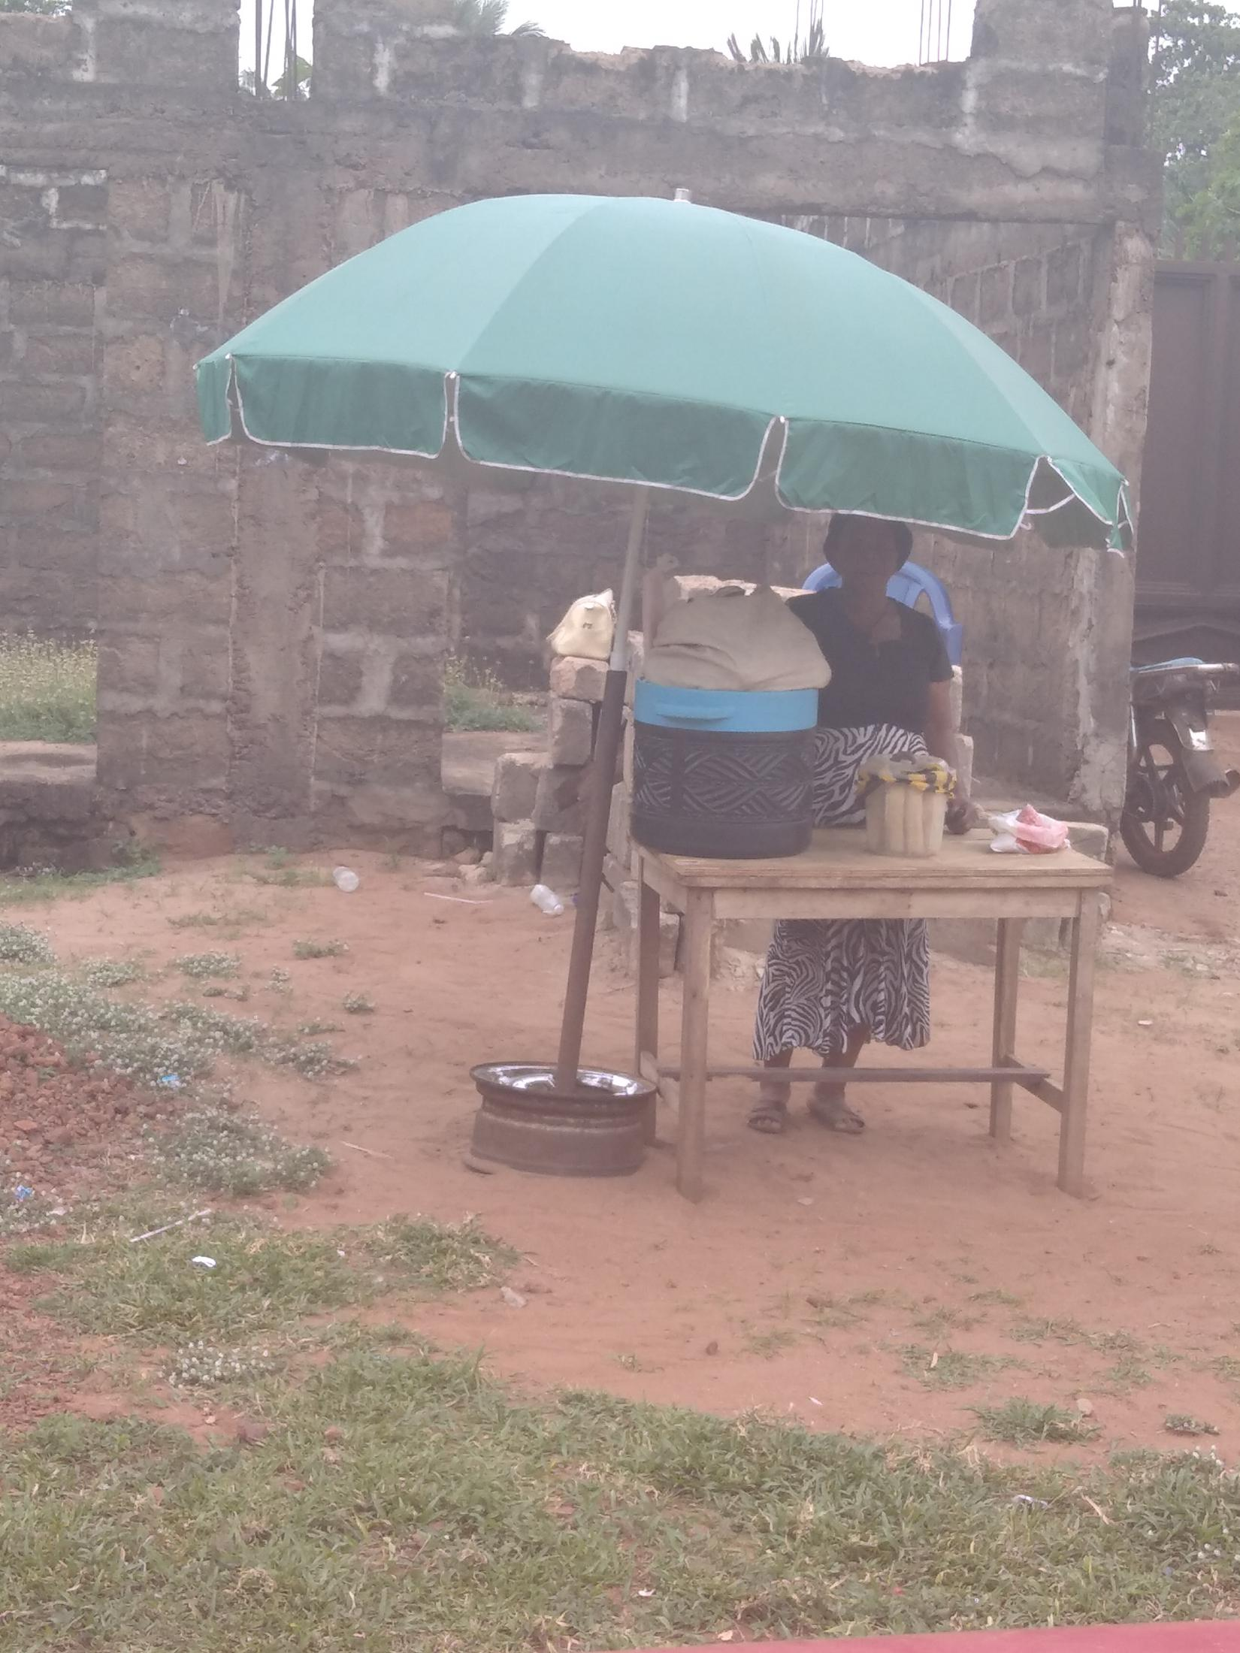
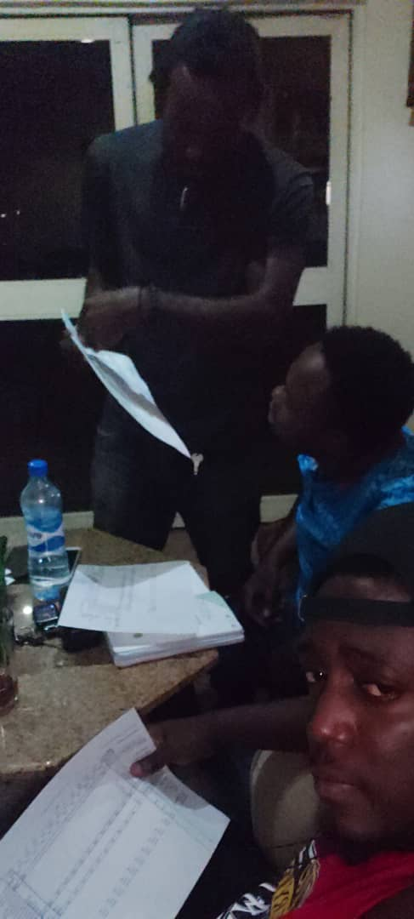
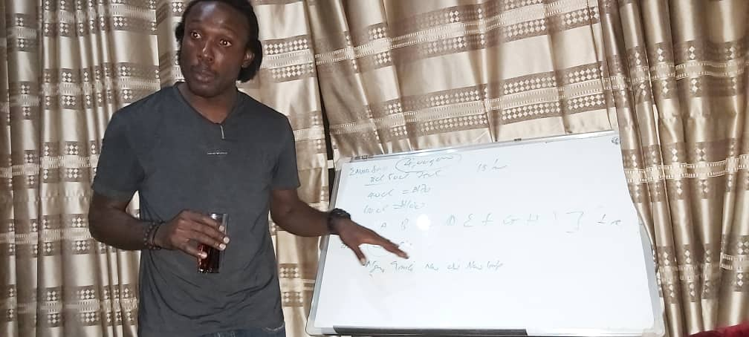
MILESTONES.
September 2018 eavorfoods was founded. we supplied only to nearby schools
January,march and august 2019 eavorfoods opened its first , second and third local greenhouses respectively, while still supplying to schools.
Note; since late 2019 we have been forming and disolving teams, because of unmarched common interests.
July 2020 eavor foods has its official website(unlunched yet).www.eavorfoods.com

Slide 8
REVENUE MODEL
INVENTORY
PRODUCTION STORAGE SALES GREENHOUSES
RETAIL. OTHER SERVICES

Slide 9
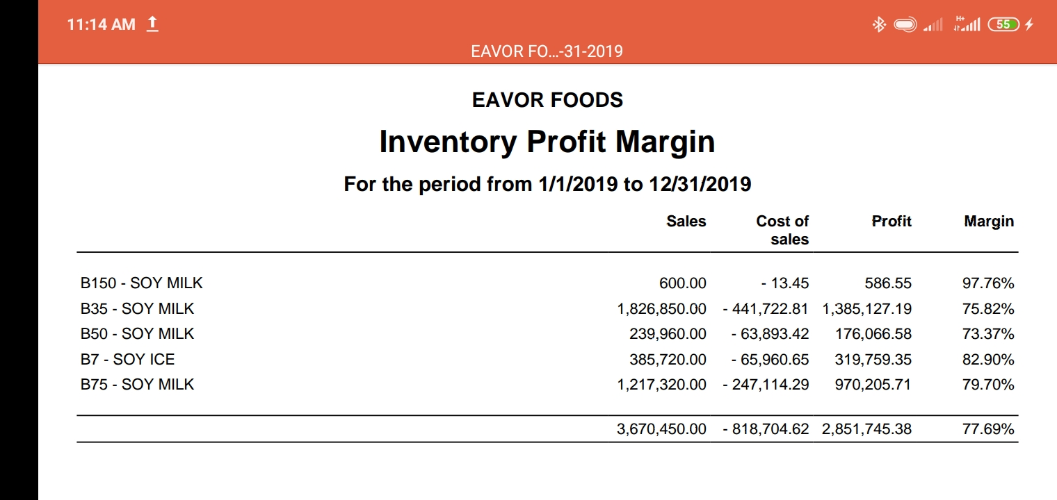
CURRENT REVENUE STREAM

Slide 10
WHY EAVOR?
Nigeria has been in distress for a long time even more so now, misplacing the word value for profit.
we are here start a resolution from this particular angle, because when we produce our core excuse is the health value we want to serve our consumers and being accountable for every taste we serve.
THANK YOU!!

